Slide 1
Machine Learning with its application in condominium market
Aloagbaye Momodu, Kejin Qian, Zhaocong Yuan
University of Toronto
July, 11th 2017

Slide 2

What is machine learning?
An abstract formal definition…
"A computer program is said to learn from experience E with respect to some class of tasks T and performance measure P if its performance at tasks in T, as measured by P, improves with experience E."
Intuitively,
A subfield of computer science that gives computers the ability to iteratively learn from data and find hidden insights without being explicitly programmed.

Slide 3
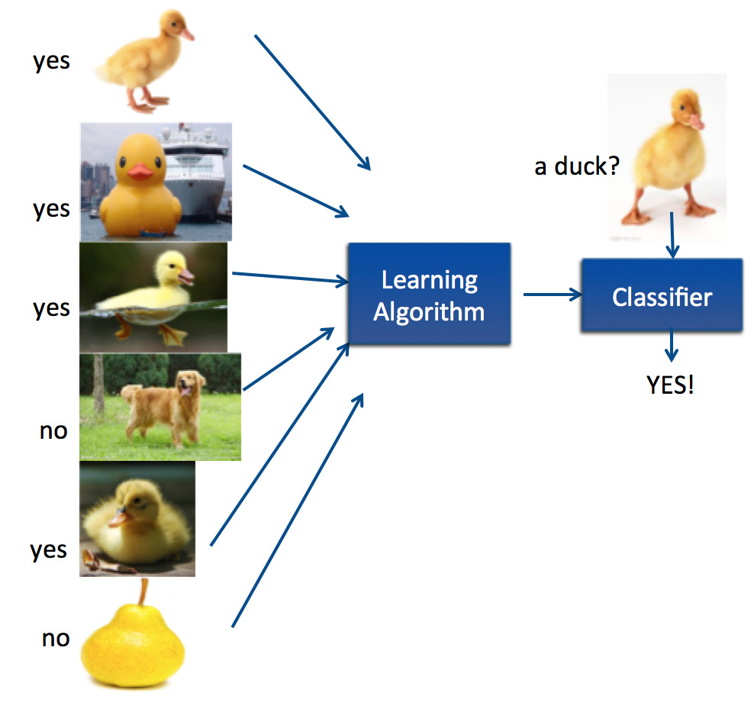
Supervised Learning
A task of inferring a function from labeled training data.
Given a training set of labeled examples {(x₁,y₁), …, (x_{N},y_{N})}, estimate the prediction function f by minimizing the cost.
Then the inferred function f can be used for mapping new examples.
Examples:
Housing price predictions
Spam email classification
Handwriting recognition

Slide 4
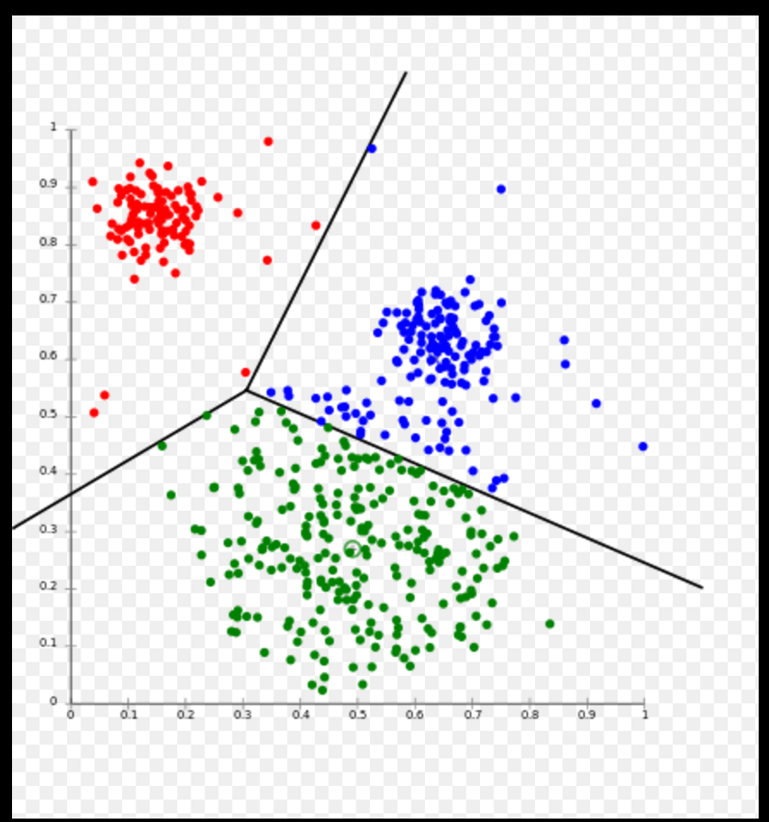
Unsupervised Learning
Used to draw inferences from datasets consisting of input data with unlabeled responses.
Clustering Analysis:
grouping a set of objects in such a way that objects in the same cluster are more similar to each other than to those in other clusters.
Examples:
Market segmentation, anomaly detection,
social network analysis

Slide 5
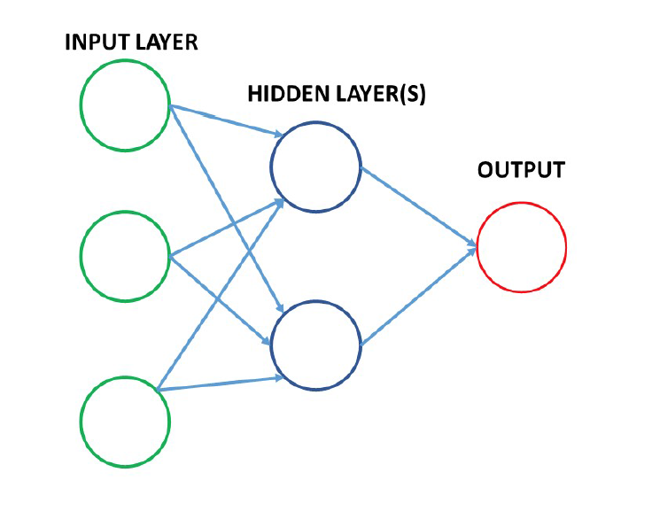
Deep Learning
Deep Learning is a class of machine learning algorithms which:
Mimics the function of the brain with layers of information processing units called artificial neural networks.
Successive layers use the output from previous layers as inputs.
Examples:
Speech recognition
Natural language processing

Slide 6
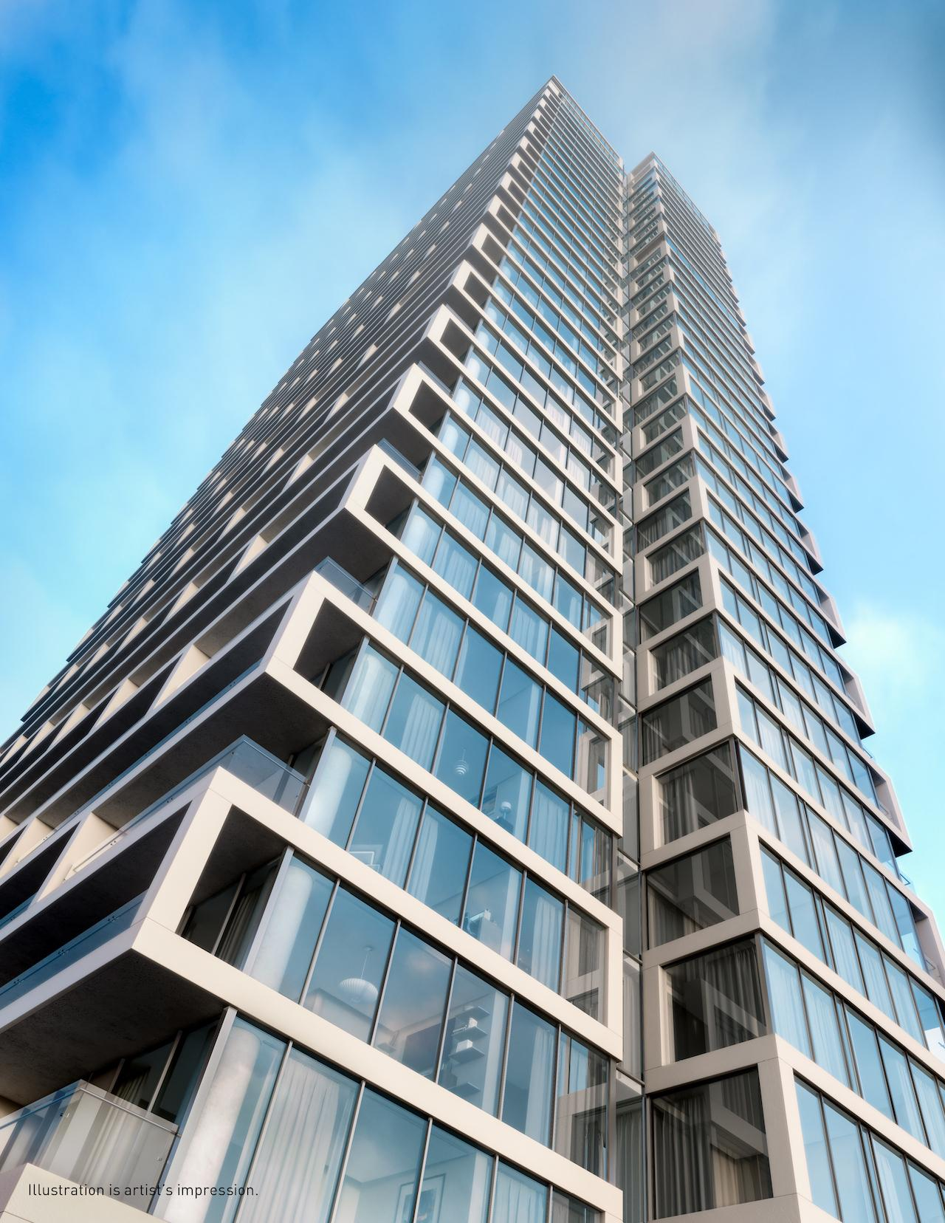
Tridel Data Analytics
Problem Definition
Investigate the crucial and influential features which greatly affect the condominium quality.
Find an effective score function that can be used to measure unit quality as a single scalar.
Design pairwise/listwise comparison models which help to predict the quality rank on any arbitrarily selected condominium units.
Use the above models to test our score function.

Slide 7
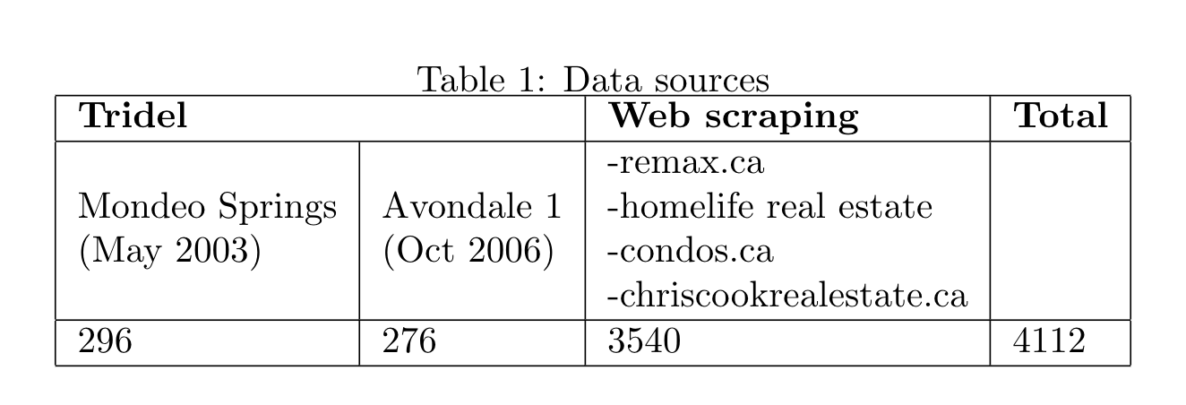
4112 condominium condominium units located in the great Toronto area, from 67/140 different neighbourhoods.
Features:
Housing Characteristics:
Unit size, number of bathrooms, number of bedrooms
Neighbourhood scores:
Crime rate, transit, health, entertainment, community, education, employment, diversity, shopping

Slide 8
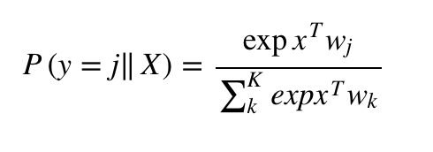


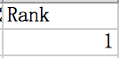
Pairwise comparison model
A simple logistic regression+ deep neural network model that takes raw feature values as inputs and provides binary outputs.
Applied a softmax to render the resulting predictions in the form of probabilities. The output of the Softmax function can be used to represent a categorical distribution, which stands for a probability distribution over 0 and 1.
Label = 1 means that unit1 is priced higher than unit2.
Unit1 has a higher quality.

Slide 9
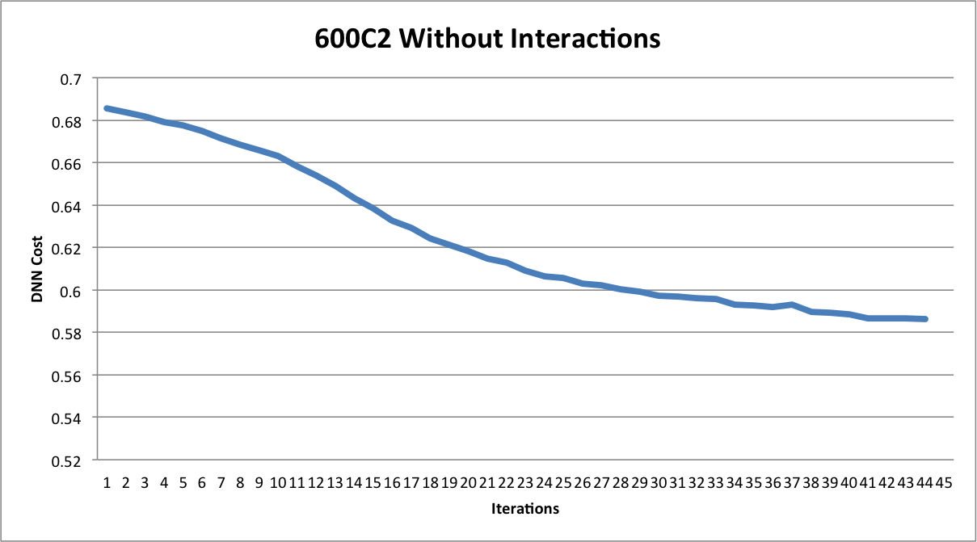
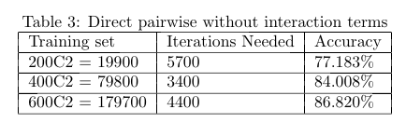
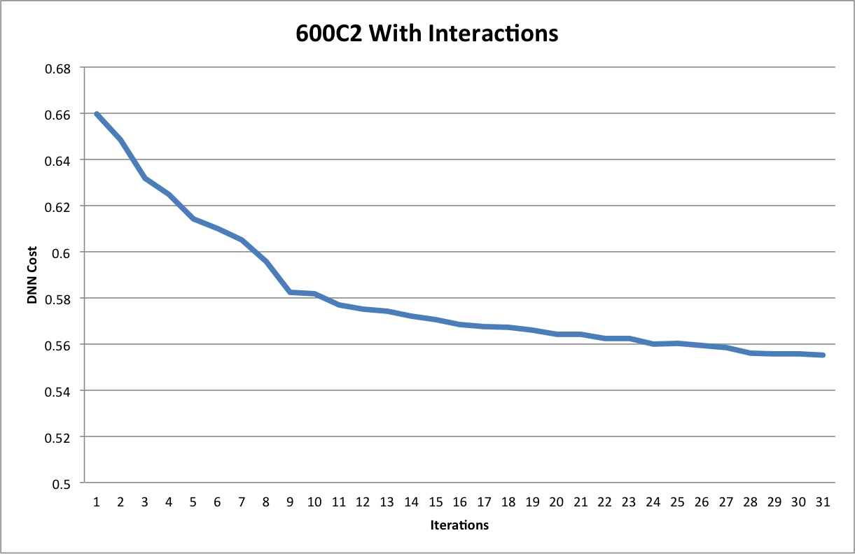
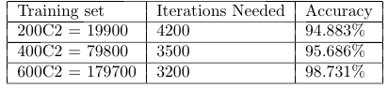
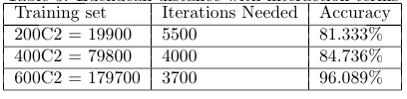
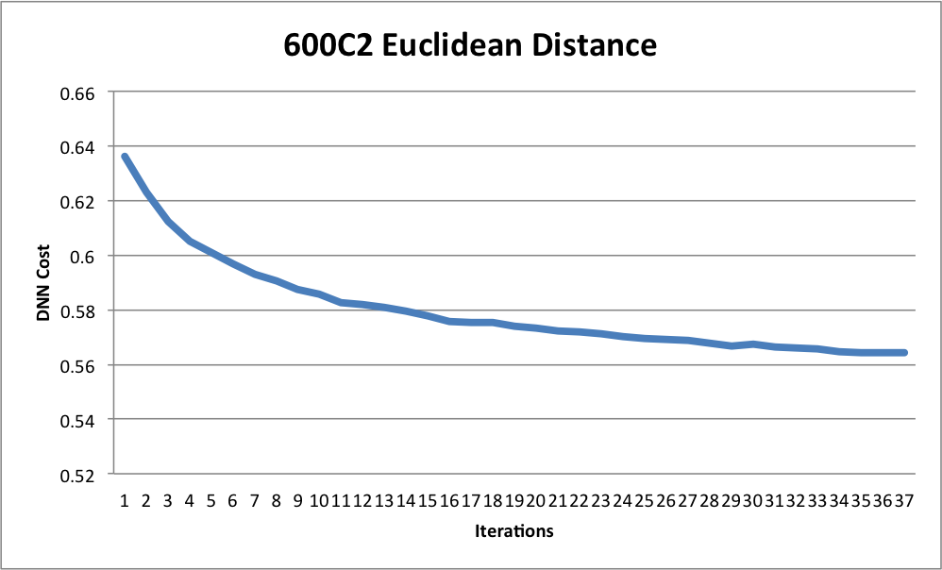
Experiment result
Case1: Direct pairwise comparison without interactions
Case2: Direct pairwise comparison with interactions
Case3: Euclidean distance with interactions

